Slide 1



Slide 2
OPERATOR
An operator is a symbol that tells the compiler to perform specific mathematical or logical functions.
Arithmetic Operators.
Unary operators.
Relational and logical operators.
Assignment operators.
Conditional operator.

Slide 3
ARITHMETIC OPERATORS
There are five arithmetic operators in C. They are
Operator | Purpose
+ | Addition
- | Subtraction
* | Multiplication
/ | Division
% | Reminder after integer division
The % operator is sometimes referred to as the modulus operator.
Always use integer values ​​when using it.

Slide 4
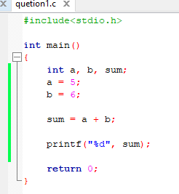
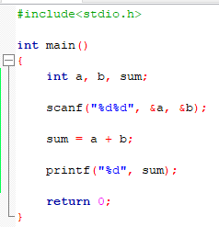
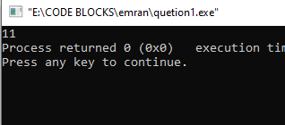
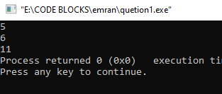
Example – 1 ( Addition ) :
By Taking
User Input
By Default
value

Slide 5
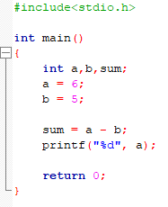
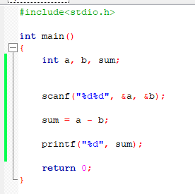
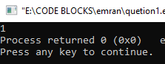
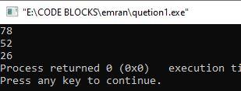
Example – 2 (Subtraction) :
By Taking
User Input
By Default
value

Slide 6
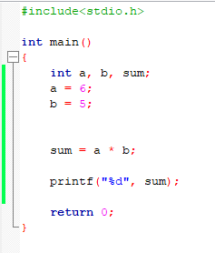
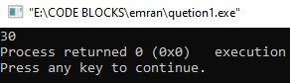
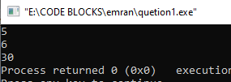
Example – 3 (Multiplication) :
By Taking
User Input
By Default
value

Slide 7
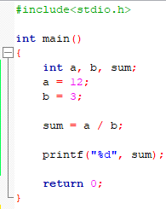
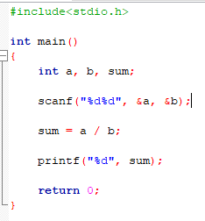
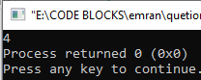
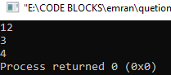
Example – 4 (Division) :
By Taking
User Input
By Default
value

Slide 8
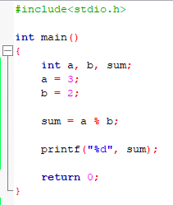
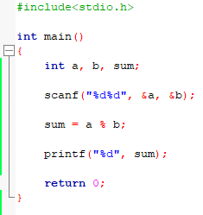
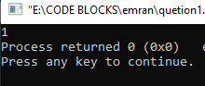
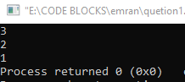
Example – 4 (Reminder) :
By Taking
User Input
For use reminder values type should be integer
By Default
value

Slide 9
TYPE CAST
To transform the type of a variable temporarily.
(data type) expression
int number;
(float) number;

Slide 10
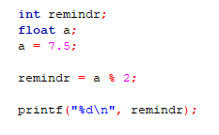
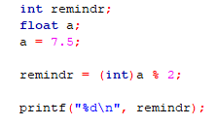
float data type
Invalid
int data type
Type Cast as a int data type
Valid
int data type

Slide 11
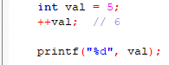
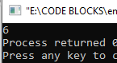
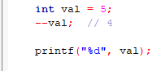
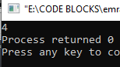
UNARY OPERATORS
Operators that operate or work with a single operand are unary operators.
For Example:
Increment ++
Decrement --

Slide 12
RELATIONAL & LOGICAL OPERATORS
There are six relational operators in C. They are,
Operator | Meaning | Type
< | Less than | Relational
<= | Greater Than | Relational
> | Less than or equal to | Relational
>= | Greater than or equal to | Relational
== | Equal to | Equality
!= | Not equal to | Equality
&& | Logical and | Logical
|| | Logical and | Logical
! | Logical and | Logical

Slide 13
RELATIONAL & LOGICAL OPERATORS USE
These six operators are used to form logical.
Expressions, which represent conditions that are
either true or false.
Value
True
1
False
0
The resulting expressions will be of type integer.

Slide 14
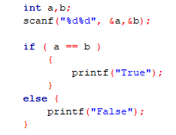
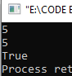
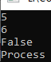
RELATIONAL & LOGICAL OPERATORS USE
a=5, b=5
a=5, b=6
Relational & Logical Operators

Slide 15
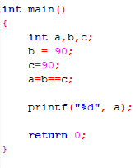
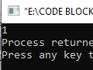
RELATIONAL & LOGICAL OPERATORS USE
b==c
true
1
a = 1
false
0
a = 0

Slide 16
RELATIONAL & LOGICAL OPERATORS EXAMPLE
Operator | Name | Example | Description
== | Equal Operator | A == B | True If A equal B else False
!= | Not Equal Operator | A != B | True If A does not equal B else False
< | Less Than Operator | A < B | True If A less than B else False
> | Greater Than Operator | A > B | True If A greater than B else False
<= | Less Than or Equal Operator | A <= B | True If A is less than or equal B else False
>= | Greater Than or Equal Operator | A >= B | True If A is greater than or equal B else False

Slide 17
ASSIGNMENT OPERATORS
expression 1 += expression 2 is equivalent to
expression 1 = expression 1 + expression 2
Example :
SUM = SUM + N
SUM += N
Similarly, the assignment expression
expression 1 -= expression 2 is equivalent to
expression 1 = expression 1 - expression 2

Slide 18
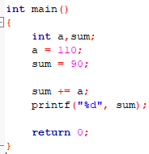
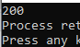
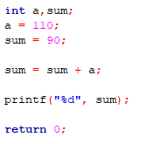
ASSIGNMENT OPERATORS USE

Slide 19
CONDITIONAL OPERATOR
Expression1 ? Expression2 : Expression3
If else type.
Expression1 = condition
Expression2 = if true then what should print?
Expression3 = else then what should print?
Example :
( i < 0 ) ? printf("True") : printf("False”)
Condition
True Value
False Value

Slide 20
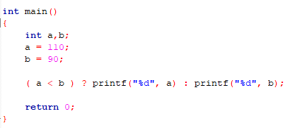
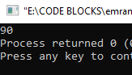
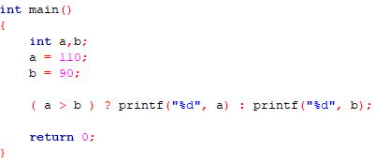
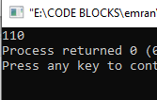

Slide 21
OPERATORS IN C
Operator | Type
++, -- | Unary Operators
+, -, *, /, % | Arithmetic Operators
<, <=, >, >=, ==, != | Relational Operators
&&, ||, ! | Logical Operators
=. +=, -=, *=, /=, %= | Assignment Operators
? | Conditional Operators

Slide 22




Halimatus Sadia
ID : 221-115-090
STUDY IN C.S.E
MD.Emran Alam
ID : 221-115-110
STUDY IN C.S.E
Anamika Chowdhury
ID : 221-115-100
STUDY IN C.S.E
Mahbuba Akther Liza
ID : 221-115-120
STUDY IN C.S.E

